Slide 1
NYC and Toronto Venue Comparison
IBM Coursera Capstone Project
By: Jimmy Amundson

Slide 2
Introduction
Business Problem:
Solution:
What new venues in Toronto or New York City would be best to invest in?
Use Foursquare to locate every venue in Toronto and NYC
Compare the presence of venue categories in Toronto and NYC to each other.
Interpret the comparison data and decide what venues could be added to each city.

Slide 3
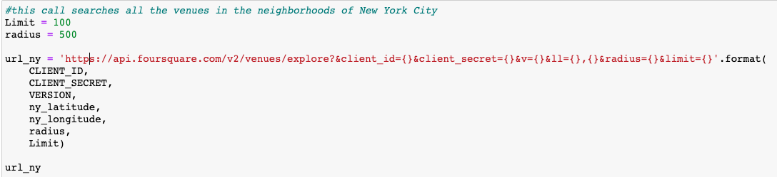
Collecting Venues with Foursquare
Use the NYC and Toronto Latitude and Longitude to call all nearby venues within a 500 meter radius
The client ID and secret are unique to my foursquare account and allow me to make calls to Foursquare.
The url_ny gives extensive information on each venue in a json file.

Slide 4
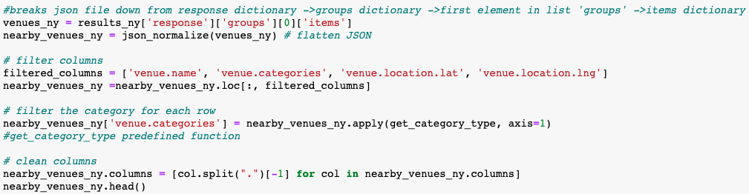

JSON →Pandas Dataframe
Every venue from each neighborhood is collected in a Json file returned by the url’s. And the venue categories are extracted and organized into a Pandas dataframe.

Slide 5
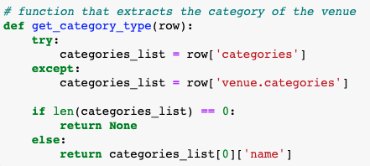
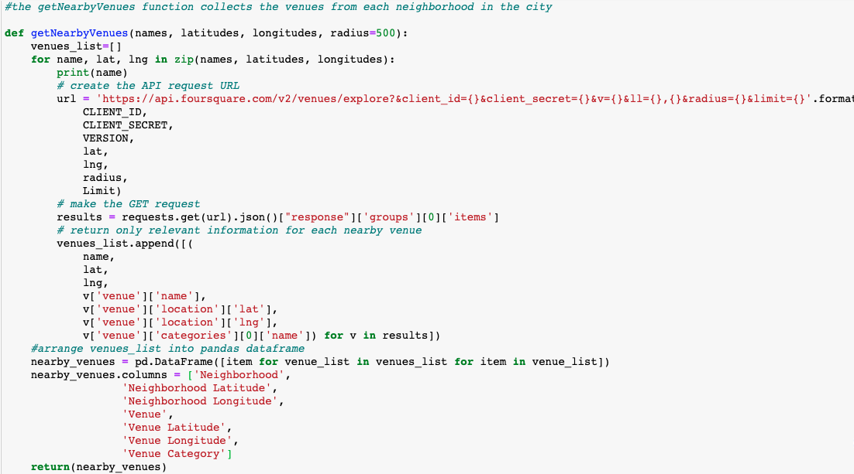
User Functions created to tabulate the venue categories into a pandas dataframe
get_category_type
getNearbyVenues

Slide 6
Total Venue Comparison
Toronto
New York City
2147 Venues
272 Venue Categories
10047 Venues
430 Venue Categories

Slide 7
Detailed Analysis
The venues returned for each neighborhood were mapped and analyzed using 3 different methods.
Top 5 venue frequency in each neighborhood
Neighborhood mapping with folium
Kmeans clustering
This information could be useful to the investor after examining the main comparison dataframe.
This is good for digging deeper, but not for answering the main business problem.

Slide 8

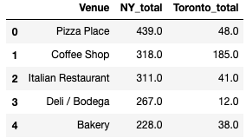
Merging the venue dataframes
A counter function was imported to count the occurrences of each venue category in each city
The dataframes of each city were combined using the pandas attribute: .merge()

Slide 9
Venue adjustment
Because NYC is way bigger than Toronto a straight across comparison would be misleading to the investor, therefore an adjustment was made.
Two adjustment methods were used.
Population Adjustment:
Venues Returned Ratio:
The NY_total column was divided by these adjustment ratios for realistic comparison

Slide 10
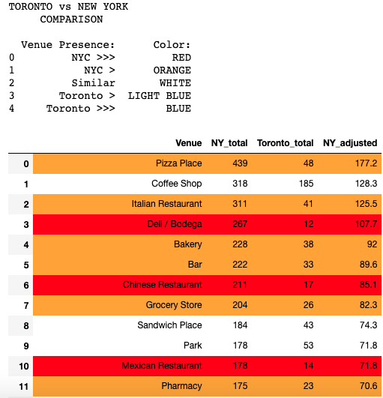
Final Comparison Dataframe

Slide 11
Population Adjustment Venue Comparison Dataframe
A user function was created to highlight the cells for easy visualization.
The legend describes the color coordination
New York City is highlighted significantly more than Toronto, meaning this adjustment ratio might be an inaccurate venue comparison method.

Slide 12
NYC adjustment
The venues returned ratio equalizes the rows highlighted for Toronto and NYC, but does not factor in city population into the adjustment.
The investor is able to compare the venues of the two cities with either adjustment ratio. Although, I believe the population adjustment ratio provides the investor with more information.
The entire venue comparison table can be viewed at https://github.com/jimboslice444/IBM_DataCourse-Capstone/blob/master/NYC%20vs.%20Toronto%20Venue%20Comparison%20analysis.ipynb

Slide 13
Conclusion
Further analysis could be done in order to pin point exactly which venue categories should be invested in by the investor rather than highlighting which venues types have potential in each respective city. By comparing other cities venues to NYC and Toronto, the investor could be more confident in their decision as well.
Based on my data analysis I recommend investing in an aquarium in NYC and an international restaurant in Toronto.

